Slide 1
Linear Regression: optimization and data normalization

Slide 2
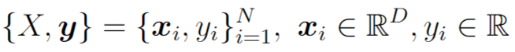
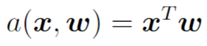
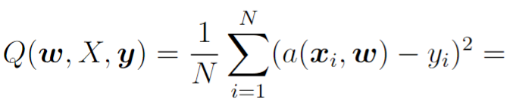
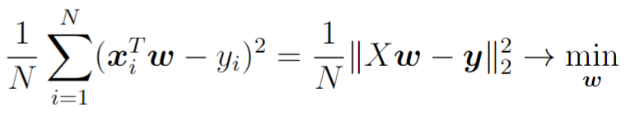
Linear model for regression
Training dataset
ML model
MSE loss function
Analytical solution

Slide 3
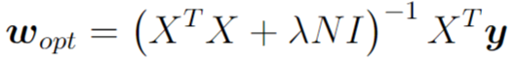
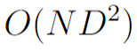
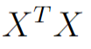
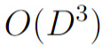
Linear regression with L2 regularization
Regularization balances approximation quality on the training set and simplicity of predictor for good generalization ability
Analytical solution:
Computational complexity of analytical solution:
for computing
for linear system solving
For large N or D finding analytical solution is too complicated.

Slide 4
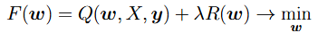
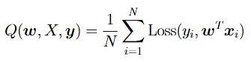
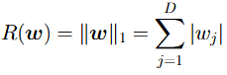
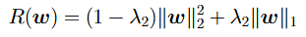
Linear regression with other losses/regularizers
Loss function can be MAE, MAPE, Huber loss, non-symmetric loss, MLSE, etc.
Regularizer also can be different:
Analytical solution for weights can be found only for the case of MSE loss + L2
Solution: let’s use numerical optimization routine

Slide 5
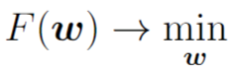
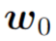
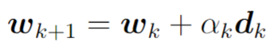
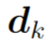
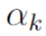
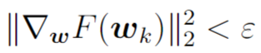
Numerical optimization
Initialize weights
Make optimization steps
Until some convergence criteria is met
- optimization direction
- step size / learning rate

Slide 6
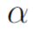
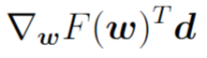
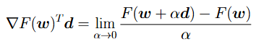
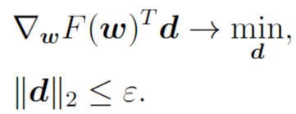
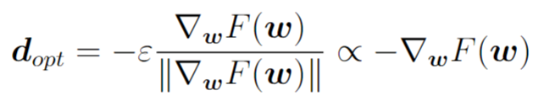
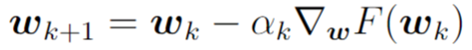
Gradient Descent (GD) optimizer
Let’s consider Taylor series expansion for function being optimized
For small enough a level of decrease is determined by
- directional derivative
Let’s find the direction with the most decrease
Gradient Descent step:

Slide 7
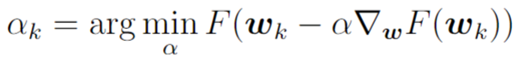
Gradient Descent optimizer
Optimization step:
Learning rate is chosen automatically by solving non-exact 1d minimization problem with Armijo/Wolfe condition (for faster computations)

Slide 8
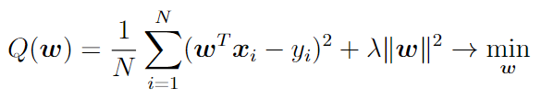
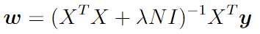
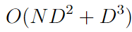
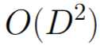
GD for linear regression
Analytical solution:
Computations costs:
Additional memory:

Slide 9
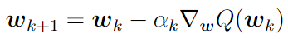
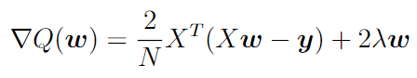
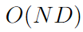
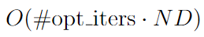
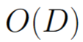
GD for linear regression
Gradient descent:
Computational costs of one iteration:
Total computational costs:
Additional memory:
For gradient-based optimization methods the total number of iterations almost doesn’t depend on optimization dimension D

Slide 10
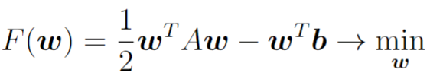
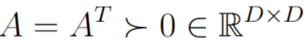
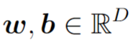
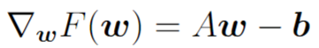
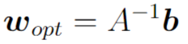
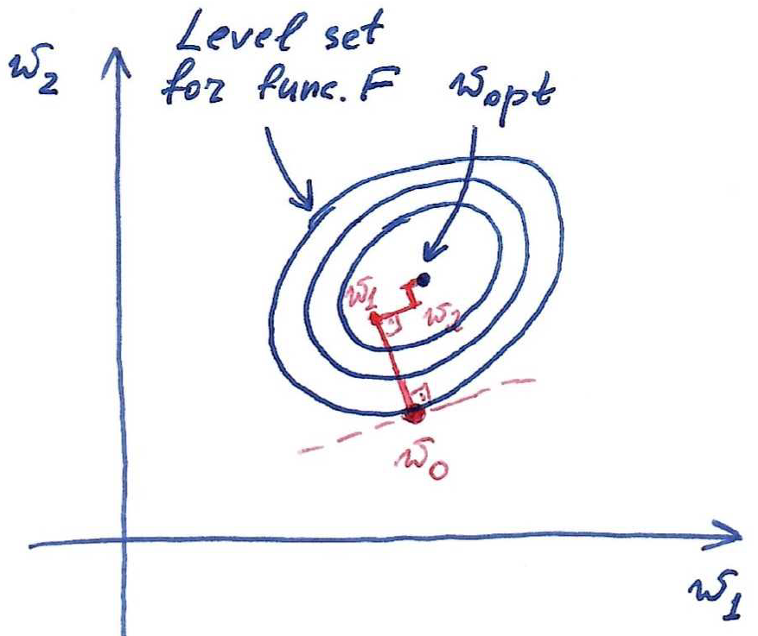
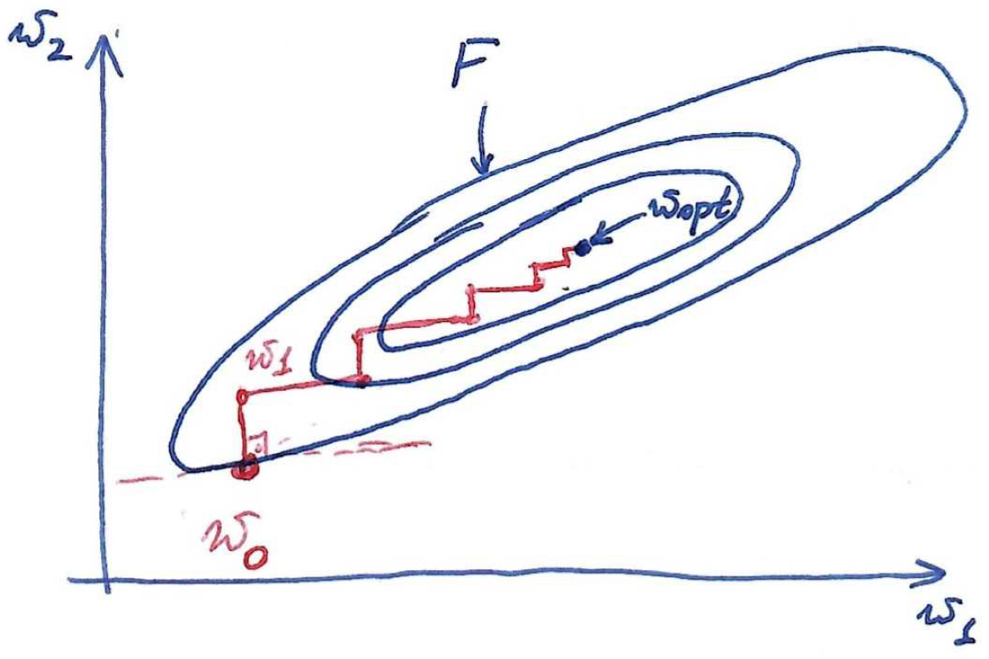
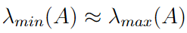
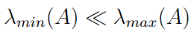
GD for quadratic function

Slide 11
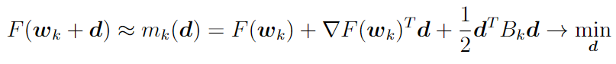
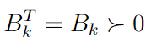
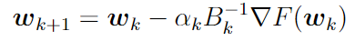
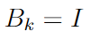
GD as approximation model
For GD:
In case of poorly scaled functions we have a mismatch between function and its approximation model

Slide 12
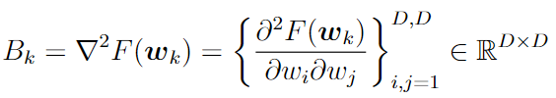
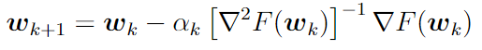
Newton optimizer
For Newton:
- Hessian matrix
Hessian matrix helps in function curvature estimation
Newton iterate:
For quadratic function Newton method converges in one iteration regardless of the condition number (scaling) of the function

Slide 13
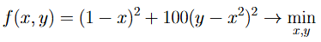


Example: Rosenbrock function

Slide 14

Example: Rosenbrock function
GD vs. Newton for Rosenbrock function

Slide 15


Example: Rosenbrock function
GD trajectory
Newton trajectory

Slide 16


Newton optimizer
Optimization step
Memory:
Computational costs:
Newton method is good w.r.t. number of iterations needed for convergence, but is very costly procedure!

Slide 17
Practical optimizers
Good optimizers have computational complexity and memory requirements similar to GD and optimization steps similar to Newton. Examples:
Conjugate Gradient
Newton-CG
L-BFGS
and others…

Slide 18

Data normalization
x – apartment, y – its cost
Different features are measured in different scales. This leads to different influence of weights to prediction.

Slide 19






Data normalization
Initial dataset
Normalization for target variable:
Mean value for each feature:
Variance value for each feature:
Normalization:

Slide 20


Data normalization on inference
All normalizing coefficients (means and variances) should be stored in memory
For test objects their features should be normalized in the same way, and target variable should be restored from normalized predictions

Slide 21



Alternative way of data normalization

Slide 22
Data normalization
Theoretically learning linear model for original and normalized data leads to the same predictor
In practice normalization can greatly help in terms of optimization, regularization and numerical stability

Slide 23


Data normalization from optimization viewpoint
After normalization

Slide 24


Data normalization w.r.t. regularization
Equivalent formulation:
In case of unnormalized data different regularization coefficients for different weights should be used.

Slide 25



Data normalization w.r.t. computation
In floating point arithmetic only relative precision is ensured:
Adding big and small numbers can lead to numerical errors in computation, e.g. in linear prediction . After normalization this problem disappears
Computations in vicinity of 1 have both good relative and absolute precision => after normalization gradient-based optimizer works more stable

Slide 26
Elements of ML pipeline for linear regression
1. Prepare your features for training with linear regression model
Exploratory data analysis, categorical features conversion
2. Add data normalization within ML pipeline
Use sklearn.preprocessing and sklearn.pipeline
3. Add regularizer and tune regularization coefficient
Use sklearn.model_selection
4. Choose optimizer
Use e.g. L-BFGS for normal size datasets and some stochastic optimizer
for large datasets
5. Control quality of obtained predictor with cross validation
Use sklearn.metrics and sklearn.model_selection

Slide 27
Stochastic Optimization

Slide 28
Optimization for linear regression
Gradient descent:
Computational costs of one iteration:
Total computational costs:
Using GD and other classic optimizers can be complicated for large datasets, i.e. when N is large. Solution: stochastic optimizers.

Slide 29





Recap on random variables
Discrete random variable x is determined by its pmf (probability mass function)
One sample from pmf can be arbitrary. With many samples their ratios converge to probability values.

Slide 30





Recap on random variables
Real-valued random variable x is determined by its pdf (probability density function)

Slide 31






Main statistics of random variables
Mean or Expected value (typical value):
Variance (deviation from typical value):
Standard deviation:

Slide 32


Main statistics of random variables
Three-sigma rule:

Slide 33









Estimating mean value by averaging samples
Suppose computational cost for drawing one sample x
Computational cost for
Very slow decrease w.r.t. j

Slide 34









Optimization for large datasets
Here is loss function for i-th object and
is some regularizer
Computational costs for
Computational costs for
Stochastic optimizers = methods with computational costs of one iteration that do not depend on N

Slide 35



Stochastic Gradient Descent (SGD)
SGD = take one random object from the dataset to estimate the gradient:
Computational costs of one SGD iteration:
Stochastic gradient is unbiased estimate of full gradient:

Slide 36



SGD with mini-batches
Take several random objects from the dataset and average:
Big mini-batches have high computational costs but doesn’t sufficiently reduce standard deviation of stochastic gradient
Computational costs of one SGD iteration with mini-batch:

Slide 37

SGD with mini-batches
Implementation: instead of random batch sampling on every iteration shuffle training objects ordering once per epoch and cycle over them

Slide 38


SGD for one-dimensional linear regression

Slide 39


SGD vs GD
In full-batch GD step size is automatically adapted looking at
In SGD step size is a hyperparameter and should be tuned by user
In full-batch GD there is a valid stopping criteria:
In SGD stopping moment is determined by user

Slide 40



Choosing step size in SGD
For SGD it is possible to prove the following theoretical result:

Slide 41



Constant step size in SGD
Output of optimizer is averaged point:

Slide 42

Constant step size in SGD
General recommendation:
In the beginning of optimization choose the largest step size that leads to loss decreasing
When loss stabilizes decrease the step size
Do decrease several times

Slide 43





Diminishing step size in SGD
For Full GD:
For SGD:

Slide 44

Narrow/wide minima of non-convex loss

Slide 45




SGD as noisy full gradient descent
Stochastic gradient can be interpreted as full gradient plus random normal noise with zero mean and variance inversely proportional to batch size:

Slide 46



SGD for non-convex functions
Full GD with proper step size
SGD with little noise
SGD with larger noise

Slide 47

Loss function convexity
The following function is convex w.r.t. w for arbitrary convex Loss:
Linear regression, logistic regression, support vector machines: all minimize convex losses
Neural Network: non-convex loss minimization

Slide 48


Scaling of SGD steps
GD iteration:
GD works bad for poorly scaled functions
Newton iteration:
Goal: find easy-to-compute scaler (not full Hessian) in stochastic case

Slide 49



SGD + momentum
Heavy ball interpretation
Adding momentum is equivalent to geometric averaging of previous gradients

Slide 50


AdaGrad and RMSProp
AdaGrad uses component-wise scaling (diagonal approximation of curvature matrix)
RMSProp allows to forget earlier curvature estimations (good for non-convex functions)

Slide 51

ADAM
ADAM combines momentum idea with averaging of gradients and RMSprop idea of component-wise scaling
Sometimes ADAM is prone to overfitting (for non-convex functions) and in this case SGD+momentum should be used

Slide 52


ADAMW
Treats L2 regularizer separately:
Here g_k is stochastic gradient for loss function:
ADAMW usually shows better performance than ADAM

